Slide 1
Cloning strategies in Rhizobium
An overview
KK

Slide 2
PCR
Make Genomic DNA from Rlv 3841 using Qiagen Blood easy Kit
3d old Slopes resuspend in 5ml TY wash twice and use 1ml for DNA prep
Final Elution of the column 3 times (3 different Eppi’s) 100ul
Dilute Elute to 2/100μl and use
PCR from Rlv 3841 for cloning purposes use Phusion Master Mix (HF)
Normally 50ul
Primer concentrations 5pmols/μl
5ul diluted DNA in each reaction
If you are happy about the product not necessary clean using PCR purification column
If you do elute, Elute in 15μl and follow pJET cloning

Slide 3
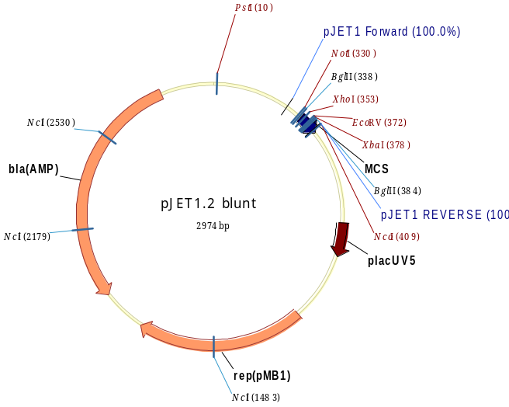
pJET Cloning
Primers with Restrictions sites
XhoI/XbaI
NotI/XbaI
Clone the cassettes in unique sites such as BamHI/EcoRI/SmaI/HindIII

Slide 4
Cloning into pJQ200SK (with interposon cassettes)
XhoI/XbaI from pJET1.2 clone into pJQ200SK
If problems, Digest with NotI/XbaI and clone
BglII digest fragment in pJET and clone directly into BamHI of SK/KS

Slide 5
pHP45 Omega cassettes
EcoRI/BamHI/HindIII/SmaI
Digest with PstI to get rid of the vector, however, Omega Kan has an internal PstI
Start with more plasmid before doing the digestions

Slide 6
In frame deletion mutants
Primers with usual 3 kb products
Inverse PCR without the gene of interest with Restriction site (eg BamHI on the primer)
After PCR digest with BamHI and ligate
Confirm BamHI by digest and sequencing
Transform
Digest with BamHI and ligate BamHI interposon cassette
Usual cloning into pJQ200SK
Single recombination and Sucrose selection
Patch on TY Str (for Rlv3841) plus interposon marker
Mapping primer along with pOTfarForward

Slide 7
Making markerless in frame deletion mutants
Clone the fragment without the cassette
The clone without the cassette (may be just the BamHI digested version before)
Digest with BglII into BamHI into pJQ200SK
Conjugate into original interposon mutant
Select for pJQ200 marker (i.e. gent) to ensure single integration
Select on sucrose and screen for Str resistant, gen sensitive and original interposon marker sensitive
PCR mapping and sequence the junctions

Slide 8
Exchange cassettes
Use pJQ173/pJQ175 (gent and Spec)
Conjugate into your strain eg Kan
Select on TY/AMA Sucrose
Select for resistant
Map
Repeated attempts suggests this only works with native Tn5

Slide 9
Cre/lox system to make markerless deletions
Digest pCM184 (digest with PvuII/Ecl136II) to get kan/lox cassette (Blunt ends)
Blunt ends so clone into any unique Blunt enzyme sites (EcoRV/SmaI) in your gene of interest cloned in pJET1.2.
XbaI/XhoI or BglII into pJQ200SK/KS
Sucrose selection Kan/Str and PCR map to isolate mutant (why are you switching between Neo and Kan. Surely it is important to stick to one)
Mutant strain conjugate S17.1 with pCM157 (MoldK1) Tet
Conjugation and select for TY str Neo (Surely this is TY Str Tet because you need to select for Cre plasmid pCM157 going into the strain)
Patch them onto Str neo and Str only
Str resistant ones grow them on TY without Tet with a couple of changes during the day (may be 3-4 times)
Dilute them and plate on TY str plates
Patch them onto TY str and TY str Tet ( The colonies not growing on Tet are correct, map them with primers

Slide 10
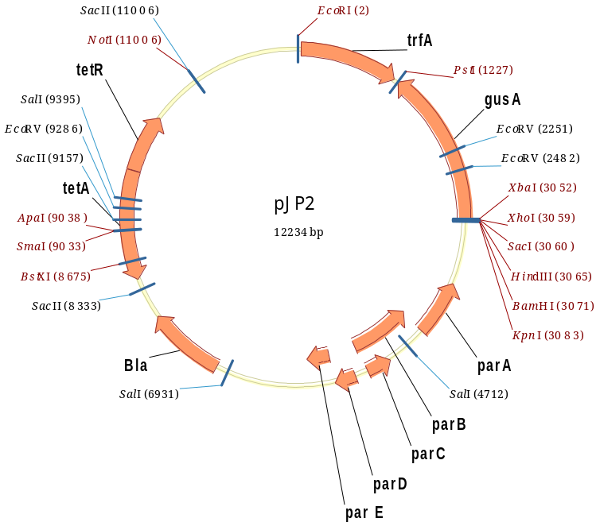
Complementing Omega mutants
pJP2
Use XbaI/BamHI
XbaI/XhoI
XbaI/KpnI
XbaI/HindIII

Slide 11
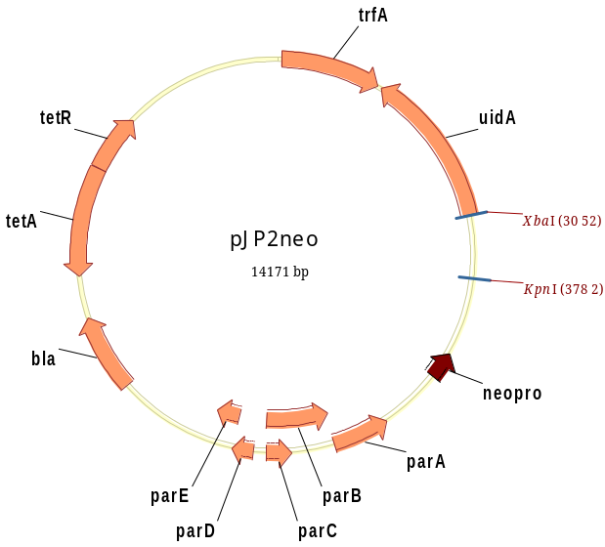
pJP2 neo
Use only XbaI/KpnI
For pIJ11268 (pJP2 Lux) use KpnI/BamHI

Slide 12
pRU1097/pOT series vectors
High Copy number
Egfp/gfpUV
Use SpeI/HindIII
We do have mcherry in pRU1097 series
Regulatable mcherry (pLMB426)
constitutive pTac mch (pLMB447)
constitutive pTac mch/Regulatable egfp (pLMB449)
We have them in Kan version also pLMB617/618/619

Slide 13
Transformation
DH5 alpha for normal Cloning
S17.1 to avoid kan resistant in triparental mating
XXXX is S17-1 in a dap auxotroph background
Brought in Competent cells Bioline Gold efficiency, Silver efficiency
C803 usual cloning (Allan Downie)
A118 E. coli strain which contains a chromosomally located copy of Tn5::B20lac.

Slide 14
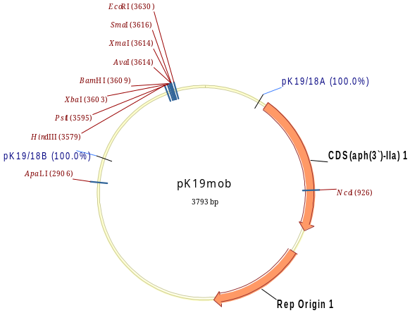
pK18/19 mob
Usually 500bp intergenic region to make mutants
XbaI/HindIII

Slide 15
New vectors not used yet
pET Duet Protein expression (MD4 H24)
pGLR1/2 MD4 H25/26 (dual GFP-luxCDABE cassette)
IRBG74 (MD4 G04/05)
ORS571 MD4 E1
pJQ200mp18 Kn MD4 K6
pJQ200mp18 Sp MD4 K7

Slide 16
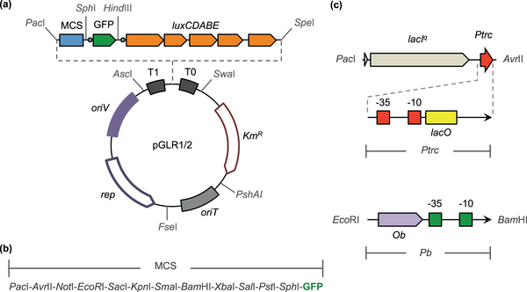
pGLR1/R2
Map

